Slide 1
INB/N371 Data Structures and Algorithms
LECTURE 2
Introduction to Arrays
(Acknowledgement: some slides are adapted from lecture slides by
Nyhoff, ADTs, Data Structures and Problem Solving with C++)
Dr. Yue Xu
School of Information Technology
Queensland University of Technology

Slide 2
This Week
Introduce arrays
Static arrays
Multidimensional arrays
Dynamic arrays
String type
Reference: Chapter 3, Section 5.2, Nyhoff textbook

Slide 3
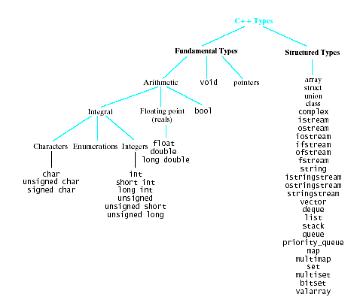
C++ Types
C++ provides large collection of data types and structures

Slide 4
Example – Flight seats management
Consider example of an airplane flight with 300 seats to be assigned
Tasks
List available seats
Reserve a seat
Cancel reservation
How to store, access data?
300 individual variables ?
An array of 300 items

Slide 5
Arrays
Data structure built into C++
A group of consecutive memory locations
All of same type
All referred by the same name
Each accessed by using indices (also called subscripts) that specify the position of the element

Slide 6

One Dimensional Static Arrays
Static array
Compiler determines how memory allocated
Syntax: ElementType arrayName [CAPACITY]; ElementType arrayName [CAPACITY] = { initializer_list };
int b[10]={0,11,22,33,44,55,66,77,88,99};
Elements accessed by
Array name and element index: b[5]

Slide 7

One Dimensional Static Arrays
Size of the array has to be determined at compile time.
Elements of an array can be of any type
Example: char name[10] = "John Doe";
If array initialized shorter than specified
extra locations filled with null character

Slide 8
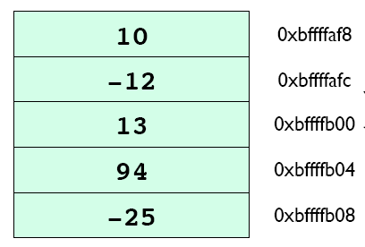
Array Storage
The elements of an array are stored consecutively in memory
E.g.,
int listOfNums[5]={10, -12, 13, 94, -25}

Slide 9
How Arrays Work
To figure out how to access an array element, the compiler needs:
The base address of the array in memory
The index of the element
The size of the element data type in bytes
element address = base address + size-of-data-type * index
This works because arrays are stored contiguously
First element of an array is at index 0, not 1

Slide 10
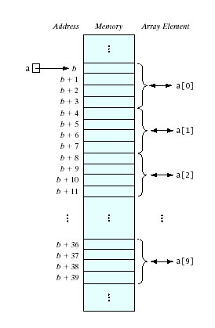
Subscript Operation
Name of the array is a pointer constant
The base address – the address of the first element
Consider the [ ] to be an operator
The subscript operator
Performs address translation
element address = base address +
size-of-data-type * index

Slide 11
Functions
Functions are used to group together related lines of code. A function usually performs a single operation.
Function definition
Return-type name(parameter-list)
{
statement-list
}
Function prototype
Before a function can be used, it must be declared. This can be done by giving its prototype:
Return-type name(parameter-list);
Function invocation: to call a function
name(argument-list);

Slide 12
Passing Data to Functions
Pass-by-value
F1()
{ int a=10;
F2(a);
//a=?
….
}
F2(int b)
{ b = 20; }
10
Parameters are used to transfer data between functions.
When a function is invoked, the number and type of arguments must match the number and type of parameters.
Pass-by-value. This means
the value of an argument is copied into the corresponding parameter .
All operations on the parameter in the called function are performed only on the parameter.
The value of the argument will not change.

Slide 13
Passing Data to Functions
Parameters to a function can be pass-by-reference.
When a parameter is passed to a function by reference, it is the address of the actual argument that is passed to the parameter so that changes can be made to the actual argument and not just a local copy.
Pass-by-reference
F1()
{ int a=10;
F2(a);
//a=?
….
}
F2(int &b)
{ b = 20; }
20

Slide 14
Arrays as Parameters to Functions
F1()
{ int a[2]={10,20};
F2(a);
//a[0]=?
….}
F2(int b[])
{ b[0] = 100; }
Pass-by-reference
Pass-by-reference
F1()
{ int a[2]={10,20};
F2(a);
//a[0]=?
….}
F2(int &b[])
{ b[0] = 100; }
100
Arrays can be used as parameters passed to functions
Arrays are passed by reference
What is actually getting passed is the address of the first element of the array
Do not use & when declaring an array as a formal parameter
Modifying an array formal parameter will also modify the corresponding actual argument in calling function
illegal

Slide 15
Arrays as Parameters to Functions
In function definition
Specify the type of the parameter array
Specify the name of the parameter array
For one-dimensional arrays, the size of the array is usually omitted
void display(int theArray[], int numValues)

Slide 16
Arrays as Parameters to Functions
#include <iostream>
using namespace std;
void display(int theArray[], int numValues); //function prototype
int main()
{
const int CAPACITY = 100;
int aArray[CAPACITY] = {4,23,45,15,27,98,12,3,9,42};
display(aArray, 10);
return 0;
}
void display(int theArray[], int numValues)
{
for(int i = 0; i < numValues; i++)
cout << theArray[i] << “ ”;
cout << endl;
}

Slide 17

Arrays as Parameters to Functions
Modifying array parameter will change the original array
#include <iostream>
using namespace std;
void display(int theArray[], int numValues); //function prototype
void modify(int theArray[], int numValues);
int main()
{
const int CAPACITY = 100;
int aArray[CAPACITY] = {4,23,45,15,27,98,12,3,9,42};
modify(aArray, 10);
display(aArray, 10);
return 0;
}
void modify(int theArray[], int numValues)
{
for(int i = 0; i < numValues; i++)
theArray[i] = theArray[i] +5;
}
void display(int theArray[], int numValues){ ….. }

Slide 18
Arrays as Parameters to Functions
Return value from function
#include <iostream>
using namespace std;
int indexLargestElement(int list[], int listSize);
int main()
{
const int size = 10;
int max;
int aArray[size] = {192,23,8,15,27,96,1200,78,93,312};
max = indexLargestElement(aArray, size);
cout << "The index of the largest element is " << max <<".\n";
return 0;
}

Slide 19
Arrays as Parameters to Functions
Return value from function
Functions cannot return an array.
int indexLargestElement(int list[], int listSize)
{
int index;
int maxIndex = 0;
for(index = 1; index < listSize; index ++)
if(list[maxIndex] < list[index])
maxIndex = index;
return maxIndex;
}

Slide 20
Copying Arrays
Assigning an array to another array of any type is illegal
e.g.,
int arrayOne[5] = {1,2,3,4,5};
int arrayTwo[5];
arrayTwo = arrayOne; //illegal
C++ does not allow aggregate operations on an array. An aggregate operation on an array is any operation that manipulates the entire array as a single unit

Slide 21
Copying Arrays
To copy one array into another array, we must copy it component-wise, that is, one component at a time.
e.g.,
int arrayOne[5] = {1,2,3,4,5};
int arrayTwo[5];
for(int index = 0; index <5; index++)
arrayTwo[index] = arrayOne[index];

Slide 22
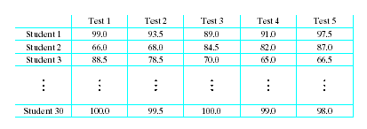
Multidimensional Arrays
Consider a table of test scores for several different students
Two-dimensional array
Syntax ElementType arrayName [numRows][numCols]

Slide 23
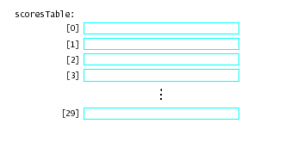
Array of Array Declarations
An array of arrays
An array whose elements are other arrays
double scoresTable [30][5]

Slide 24
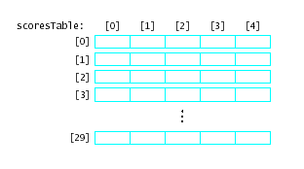
Array of Array Declarations
Each of the rows is itself a one dimensional array of values
scoresTable [2][3]
scoresTable[2]
is the whole row numbered 2

Slide 25
Memory Allocation in 2-Dimensional Arrays
Elements stored in row-wise order
The address of an element in a multi-dimensional array can be calculated based on:
Base address, the address of first element in an array
Size of the data type, e.g. 8 bytes for double type
Length of each dimension
The index of each element for each dimensions
For two dimensions:
element address = base address + size-of-data-type * length-of-dimension2*index1+ size-of-data-type*index2

Slide 26
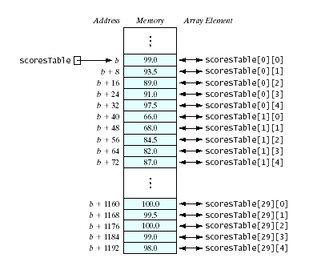
Memory Allocation in 2-Dimensional Arrays
scoresTable[30][5])
row1
Elements stored in row-wise order
The address of an element in a multi-dimensional array can be calculated based on:
Base address, the address of first element in an array
Size of the data type, e.g. 8 bytes for double type
Length of each dimension
The index of each element for each dimensions
For two dimensions:
8 * 5 bytes
Length of dimension2=5
row2
Address(scoresTable[1][3])
=b + 8*5*1 + 8*3
element address = base address + size-of-data-type * length-of-dimension2*index1+ size-of-data-type*index2

Slide 27
Memory Allocation in 2-Dimensional Arrays
scoresTable[0][4] is followed in memory by scoresTable [1][0]
Address(scoresTable[0][4]) = b +
8*5*0 + 8*4
= b + 32
Address(scoresTable[1][0]) = b +
8*5 *1+ 8*0
=b + 40

Slide 28
Multidimensional Arrays as Parameters
In function definition
For two dimensional arrays, the length of the first dimension can be omitted, the length of the second dimension must be specified.
void printMatrix(int matrix[][sizeCol], int sizeRow);

Slide 29
Multidimensional Arrays as Parameters
#include <iostream>
using namespace std;
const int sizeCol = 5;
const int sizeRow = 6;
void printMatrix(int matrix[][sizeCol],int sizeRow);
void sumRows(int matrix[][sizeCol],int sizeRow);
void largestInRows(int matrix[][sizeCol],int sizeRow);
int main()
{
int board[sizeRow][sizeCol] = {{23,5,6,15,18},{4,16,24,67,10},
{12,54,23,76,11},{1,12,34,33,8},
{81,23,12,34,56},{12,34,54,25,3}};
printMatrix(board, sizeRow);
cout<< endl;
sumRows(board, sizeRow);
cout<< endl;
largestInRows(board, sizeRow);
return 0;
}

Slide 30
Multidimensional Arrays as Parameters
void printMatrix(int matrix[][sizeCol],int sizeRow)
/*
pre: 0<= sizeRow, 0<=sizeCol
post: display integers stored in the two dimensional array
*/
{
for(int i = 0; i < sizeRow; i++)
{
for(int j=0; j<sizeCol;j++)
cout << matrix[i][j] << " ";
cout << endl;
}
cout << endl;
}

Slide 31
Multidimensional Arrays as Parameters
void sumRows(int matrix[][sizeCol],int sizeRow)
/*
pre: 0<= sizeRow, 0<=sizeCol
post: output the sum of the elements of each row in the two dimensional
array
*/
{
int sum;
for(int i = 0; i < sizeRow; i++)
{
sum = 0;
for(int j=0; j<sizeCol;j++)
sum = sum + matrix[i][j];
cout<<"The sum of row "<<(i +1) <<" = " << sum<<endl;
}
}

Slide 32
Multidimensional Arrays as Parameters
void largestInRows(int matrix[][sizeCol], int sizeRow)
/*
pre: 0<= sizeRow, 0<=sizeCol
post: determine the largest element of each row in the two dimensional array
*/
{
int largest;
for(int i = 0; i < sizeRow; i++)
{
largest = matrix[i][0];
for(int j=0; j<sizeCol;j++)
if(largest < matrix[i][j]) largest = matrix[i][j];
cout<<"The largest element of row "<<(i +1) <<" = " << largest<<endl;
}
}

Slide 33
Dynamic Arrays
Recall earlier mention of arrays being fixed size at compile time
Space wasted by unused elements
Program cannot adjust if size set too small
Dynamic (run time) allocation mechanism provided
Acquire memory as needed
Release memory when no longer needed
C++ commands
new and delete

Slide 34
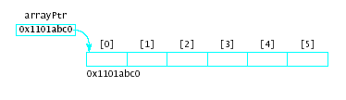
The new Operator
Syntax for arrays new Type [capacity]
This command issues a run-time request for a block of memory
Asks for enough memory for the specified number of elements of the stated type
Example int *arrayPtr, size=6; arrayPtr = new int[size];

Slide 35
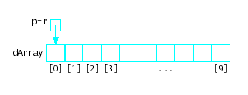
Pointers and Arrays
An array is a pointer, it points to the first element of the array.
A pointer can be used to point to the elements in an array.
int dArray[10] = {1,2,3,4,5,6,7,8,9,10};
int *ptr = dArray;

Slide 36

Pointer Arithmetic
Possible to alter pointer contents
The pointer is a variable
It is not a pointer constant like an array name
Example
Given:
int *ptr = dArray;
Then: ptr++;
ptr is increased by the
size of the element type.

Slide 37
Pointer Arithmetic (example)
int main()
{
const int size = 10;
int * numbers, *p;
numbers = new int[size];
int copy[size];
cout << "Enter " << size << " integer numbers :\n";
for(int i = 0; i < size; i++)
cin >> *(numbers + i);
cout <<"The "<< size << " numbers are: ";
for(int i = 0; i < size; i++)
cout << *(numbers +i) << " ";
cout << "\n";
……

Slide 38
Pointer Arithmetic (example)
……
p=numbers;
for(int i = 0; i < size; i++)
{ copy[i]=*numbers; numbers++; }
cout <<"The content of 'copy': ";
for(int i = 0; i < size; i++)
cout << copy[i] << " ";
cout << "\n";
cout <<"The content of 'p': ";
for(int i = 0; i < size; i++)
cout << *(p +i) << " ";
cout << "\n";
….
…….
cout <<"The content of 'numbers': ";
for(int i = 0; i < size; i++)
cout << *(numbers +i) << " ";
cout << "\n";
}

Slide 39
Scope of Variables
Scope is the context in which a variable name exists. You can use the same variable name in two (or more) functions, because the functions have different scopes.
Scope is defined
by curly brackets
int scopeExample (int para)
{
int count = 0;
for(int i=0;i<10;i++)
{
int count = 1;
. . . . . .
}
{ int count =2;
. . . . . .
}
// count = ?
}

Slide 40
Lifetimes of Variables
A lifetime is how long a variable “lives” – how long the program keeps memory allocated for it.
Variables are “born” when the program enters their scope. They “die” when the program leaves their scope.
Static variables get de-allocated right when they go out of scope.
How about dynamic variables?

Slide 41
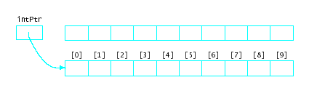
Memory Leaks
When you use a pointer to dynamically allocate memory : int *intPtr
for(int i=0;i<10;i++){
intPtr = new int[10];
. . .
}
and the pointer goes out of scope or assigned new address, the originally allocated memory now cannot be accessed, nor is it available for reallocation

Slide 42
The delete Operation
Requests memory be returned
Can then be reused by later allocations
Syntax delete pointerVariable; delete [ ] arrayPointerVariable;
Frees the dynamically allocated memory whose address is stored in the variable
Does not delete the variable

Slide 43
The delete Operation
Single variables, allocated with new, get cleaned up with the keyword delete, e.g.,
int * foo = new int;
. . .
delete foo; foo = new int;
Arrays, allocated with new and [ ], get cleaned up with keyword delete [ ], e.g.,
int * baz = new int[10];
. . .
delete [] baz;
baz = new int[5];

Slide 44
The delete Operation
Important for programmer to make sure to deallocate memory originally allocated by new using delete operation.
Otherwise you get memory leaks. Even though these are cleaned up by the operating system after the program exits, but the program can run out of memory while it is running.

Slide 45
C++ String Type
A string is a sequence of characters.
Must include the <string> library in order to use the string class: #include <string>
Define strings
string s1;
string s2 = “initialized string”;
string s3(“another one”);
Several ways to create strings, see Table 5-7 in Nyhoff text.

Slide 46
C++ String Type
Input
Use input operator “>>”
Reading a string until the end of file or a white-space character is reached. E.g., string s;
cin >> s; //input “one two three”
cout << s; // display “one”
Use method getline()
Reading a string including white spaces, delimited by a newline (‘\n’) character:
getline(cin, s);//input “one two three”
cout << s; // display “one two three”

Slide 47
Some C++ String Operations (see Appendix D, Nyhoff text)
String storage information operations
string s = “test”;
s.capacity()//return 15 in MS Visual Studio
Return the capacity of the storage allocated to the string.
s.length() //return 4
s.size() // return 4
Both return the number of characters stored in the string.
s.empty()
Return true if s contains no characters, false otherwise

Slide 48
C++ String Operations (see Appendix D, Nyhoff text)
String assignment
string s1 = “test”, s2, s3;
s2 = s1;
s3.assign(s1);
Both s2 and s3 are a true copy of s1. Changing the value of s1 will not change the value of s2 and s3.
String concatenation
s2.append(s1);
Append s1 at the end of s2, e.g., s2 becomes “testtest”

Slide 49
C++ String Operations (see Appendix D, Nyhoff text)
String comparison
Overloaded operators
!=, <, >, <=, >=, = =
e.g. string s1 = “test”,
s2 =“change”;
if(s1==s2) cout << true;
else cout << false;
Member Function compare
s1.compare(s2) returns a negative value, 0, or a positive value according as s1 is less than, equal to, or greater than s2

Slide 50
Next Week
Object-Oriented Programming and ADTs
Classes and objects
Inheritance
Polymorphism

Slide 51
Do List
Review Lecture 2
Study Nyhoff
Exercises 3.2, Exercises 3.3 questions 1 – 4 and Exercises 3.4.
Do tutorial 2 exercises

